Slide 1
Chapter 1: LAN Design
Instructor Materials
CCNA Routing and Switching
Scaling Networks v6.0
Notes:
Cisco Networking Academy Program
Scaling Networks v6.0
Chapter 1: LAN Design

Slide 2
Instructor Materials – Chapter 1 Planning Guide
This PowerPoint deck is divided in two parts:
Instructor Planning Guide
Information to help you become familiar with the chapter
Teaching aids
Instructor Class Presentation
Optional slides that you can use in the classroom
Begins on slide # 10
Note: Remove the Planning Guide from this presentation before sharing with anyone.
Notes:
2

Slide 3
Chapter 1: LAN Design
Scaling Networks 6.0 Planning Guide
Notes:
Cisco Networking Academy Program
Scaling Networks v6.0
Chapter 1: LAN Design

Slide 4
Chapter 1: Activities
What activities are associated with this chapter?
Page # | Activity Type | Activity Name | Optional?
1.0.1.2 | Class Activity | Network by Design | Optional
1.1.2.7 | Interactive Activity | Identify Scalability Terminology | Recommended
1.2.1.6 | Interactive Activity | Selecting Switch Hardware | Recommended
1.2.1.7 | Packet Tracer | Comparing 2960 and 3560 Switches | Optional
1.2.2.4 | Interactive Activity | Identify the Router Category | Recommended
1.2.3.3 | Syntax Checker | Basic Router CLI Commands | Recommended
1.2.3.4 | Syntax Checker | Basic Router Show Commands | Recommended
1.3.1.1 | Class Activity | Layered Network Design Simulation | Optional
1.3.1.2 | Syntax Checker | Basic Switch Configuration | Recommended
1.3.1.3 | Packet Tracer | Skills Integration Challenge | Recommended
Notes:
4

Slide 5
Chapter 1: Assessment
Students should complete Chapter 1, “Assessment” after completing Chapter 1.
Quizzes, labs, Packet Tracers and other activities can be used to informally assess student progress.
Notes:
5

Slide 6
Chapter 1: Best Practices
Prior to teaching Chapter 1, the instructor should:
Complete Chapter 1, “Assessment.”
The objectives of this chapter are:
Describe hierarchical small business network designs.
Explain considerations for designing a scalable network.
Select the appropriate switch hardware features to support network requirements in small to medium-sized business networks.
Describe the types of routers available for small-to-medium-sized business networks.
Configure basic settings on a Cisco IOS device.
Notes:
6

Slide 7
Chapter 1: Best Practices (Cont.)
1.1.1.2
When discussing the Hierarchical Design model, it would be helpful to compare it to a nonhierarchical design. The following URL will show in Figure 1-2 what very early networks used to look like: http://www.ciscopress.com/articles/article.asp?p=2202410&seqNum=4
Explain to students that the flat switched network had one large broadcast domain.
Show the students Figure 1-3 where they can see what a better network design looks like by using the hierarchical network design model.
1.2.1.5
Explain to students that multilayer switches are much faster than routers because the forwarding on switches is done with hardware (using ASICs) whereas routers forward using software. Hardware is much faster than software thanks to ASICs.
Consider asking students to research and talk about all the differences between a traditional router and a multilayer switch.
Notes:
7

Slide 8
Chapter 1: Additional Help
For additional help with teaching strategies, including lesson plans, analogies for difficult concepts, and discussion topics, visit the CCNA Community at: https://www.netacad.com/group/communities/community-home
Best practices from around the world for teaching CCNA Routing and Switching. https://www.netacad.com/group/communities/ccna
If you have lesson plans or resources that you would like to share, upload them to the CCNA Community in order to help other instructors.
Students can enroll in Introduction to Packet Tracer (self-paced)
Notes:
8

Slide 10
Chapter 1: LAN Design
CCNA Routing and Switching
Scaling Networks v6.0
Notes:
Cisco Networking Academy Program
Scaling Networks v6.0
Chapter 1: LAN Design

Slide 11
Chapter 1 - Sections & Objectives
1.1 Campus Wired LAN Designs
Explain why it is important to design a scalable hierarchical network.
Describe hierarchical small business network designs.
Explain considerations for designing a scalable network.
1.2 Campus Network Device Selection
Select network devices based on feature compatibility and network requirements.
Select the appropriate switch hardware features to support network requirements in small to medium-sized business networks.
Describe the types of routers available for small to medium-sized business networks.
Configure basic settings on a Cisco IOS device.
Notes:
11
Cisco Networking Academy Program
Scaling Networks v6.0
Chapter 1: LAN Design

Slide 12
1.1 Campus Wired LAN Designs
Notes:
1- LAN Design
1.1 – Campus Wired LAN Designs

Slide 13
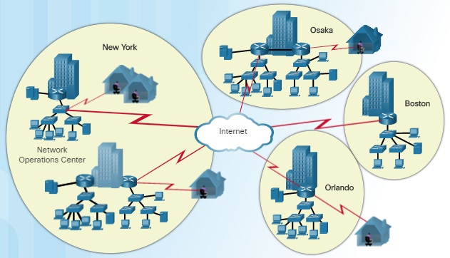
Cisco Validated Designs The Need to Scale the Network
A company with a small network with one site and a connection to the Internet might grow into an enterprise with a central location with numerous remote sites across the globe.
All enterprise networks must:
Support the exchange of various types of network traffic
Support critical applications
Support converged network traffic
Support diverse business needs
Provide centralized administrative control
The LAN is the networking infrastructure that provides access to network resources for end users over a single floor or a building.
Notes:
1.1 – Campus Wired LAN Designs
1.1.1 – Cisco Validated Designs
1.1.1.1 – The Need to Scale the Network

Slide 14
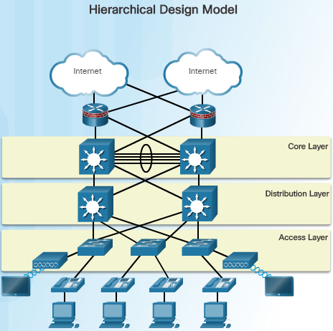
Cisco Validated Designs Hierarchical Design Model
The campus wired LAN uses a hierarchical design model to break the design up into modular layers.
Breaking the design up into layers allows each layer to implement specific functions, which simplifies the network design for easier deployment and management.
A hierarchical LAN design includes three layers as shown in the figure:
Access layer
Distribution layer
Core layer
Some smaller enterprise networks implement a two-tier hierarchical design and collapse the core and distribution layers into one layer.
Notes:
1.1 – Campus Wired LAN Designs
1.1.1 – Cisco Validated Designs
1.1.1.2 – Hierarchical Design Model

Slide 15
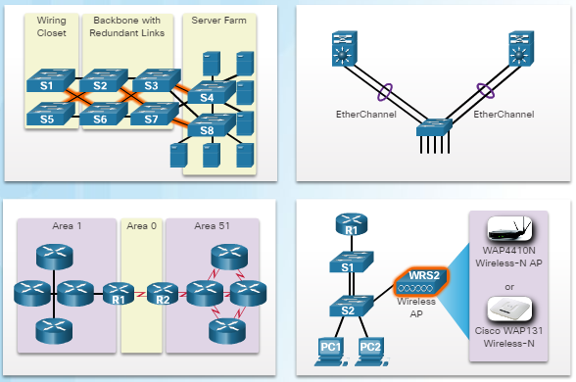
Expanding the Network Design for Scalability
The network designer must develop a strategy to enable the network to be available and scale easily and effectively.
Use expandable, modular equipment or clustered devices that can be easily upgraded to increase capabilities.
Design a hierarchical network to include modules that can be added, upgraded, and modified as needed.
Create an IPv4 or IPv6 address strategy that is hierarchical.
Choose routers or multilayer switches to limit broadcasts and filter undesirable traffic from the network.
Implement redundant links between critical devices and between access and core layers.
Notes:
1.1 – Campus Wired LAN Designs
1.1.2 – Expanding the Network
1.1.2.1 – Design for Scalability

Slide 16
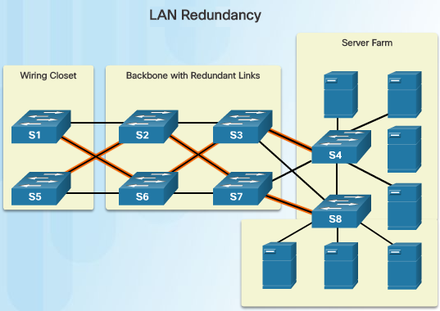
Expanding the Network Planning for Redundancy
Redundancy is an important part of the network design for preventing disruption of network services.
Minimize the possibility of a single point of failure by recognizing these facts:
Installing duplicate equipment and providing failover services for critical devices is necessary.
Redundant paths offer alternate physical paths for data to traverse the network.
Spanning Tree Protocol (STP) is required with redundant paths in a switched Ethernet network to prevent Layer 2 loops.
STP provides a mechanism for disabling redundant paths in a switched network until the path is necessary such as when a failure occurs.
Notes:
1.1 – Campus Wired LAN Designs
1.1.2 – Expanding the Network
1.1.2.2 – Planning for Redundancy

Slide 17
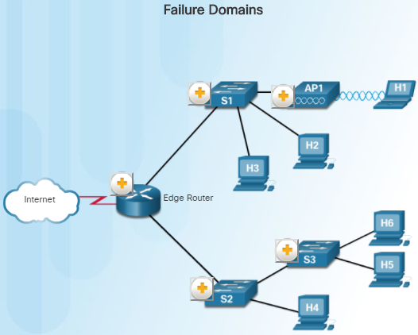
Expanding the Network Failure Domains
A well-designed network should limit the size of failure domains.
A failure domain is the area of a network that is impacted when a critical device or network service experiences problems.
The function of the devices that fail will determine the impact of the failure domain.
Use redundant links and reliable enterprise-class equipment to minimize the disruption in a network.
Smaller failure domains reduce the impact of a failure but also make troubleshooting easier.
Notes:
1.1 – Campus Wired LAN Designs
1.1.2 – Expanding the Network
1.1.2.3 – Failure Domains

Slide 18
Expanding the Network Failure Domains (Cont.)
In the hierarchical design model, it is usually easier to control the size of a failure domain in the distribution layer.
In the distribution layer, network errors can be contained to a smaller area which will impact fewer users.
When using Layer 3 devices at the distribution layer, every router functions as a gateway for a limited number of access layer users.
Switch Block Deployment
Routers or multilayer switches are usually deployed in pairs with access layer switches evenly divided between them.
Each switch block acts independently of the others, which reduces the impact of failures.
Notes:
1.1 – Campus Wired LAN Designs
1.1.2 – Expanding the Network
1.1.2.3 – Failure Domains

Slide 19
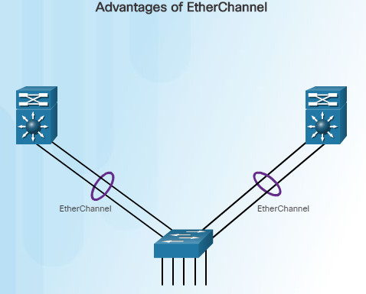
Expanding the Network Increasing Bandwidth
In a hierarchical network design, some links between access and distribution layer switches may need to process a greater amount of traffic than other links do.
As multiple links converge into a single link, it is possible for this link to become a bottleneck.
EtherChannel is a form of link aggregation that will allow the network administrator to increase the amount of bandwidth between devices by creating one logical link out of several physical links.
EtherChannel uses existing switch ports.
The EtherChannel configuration takes advantage of load balancing between links that are part of the same EtherChannel.
Notes:
1.1 – Campus Wired LAN Designs
1.1.2 – Expanding the Network
1.1.2.4 – Increasing Bandwidth

Slide 20
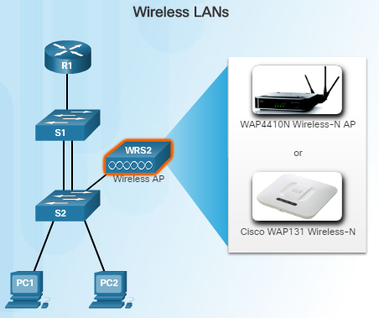
Expanding the Network Expanding the Access Layer
Wireless connectivity is an important aspect of extending access layer connectivity.
The network must be designed to be able to expand network access to individuals and devices, as needed.
Advantages of wireless connectivity include increased flexibility, reduced cost, and the ability to adapt to changing network and business requirements.
End devices require a wireless NIC that incorporates a radio transmitter/receiver, appropriate software drivers, and also a wireless access point (AP) to connect to.
Notes:
1.1 – Campus Wired LAN Designs
1.1.2 – Expanding the Network
1.1.2.5 – Expanding the Access Layer

Slide 21
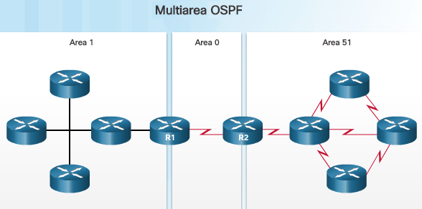
Expanding the Network Fine-tuning Routing Protocols
Advanced routing protocols, such as OSPF and EIGRP are used in large networks.
Link-state routing protocols such as OSPF works well for larger hierarchical networks where fast convergence is important.
Single Area OSPF has one area – Area 0.
Cisco’s proprietary distance vector routing protocol, called EIGRP, is another popular routing protocol. It is designed for larger networks using primarily Cisco routers.
Although the configuring EIGRP is simple, the underlying features and options of EIGRP are extensive and robust.
OSPF supports a two-layer hierarchical design, referred to as multiarea OSPF.
Multiarea OSPF requires an Area 0 (backbone area)
Non-backbone areas must be directly connected to Area 0.
Notes:
1.1 – Campus Wired LAN Designs
1.1.2 – Expanding the Network
1.1.2.6 – Fine-tuning Routing Protocols

Slide 22
1.2 Selecting Network Devices
Notes:
1- LAN Design
1.2 – Selecting Network Devices

Slide 23
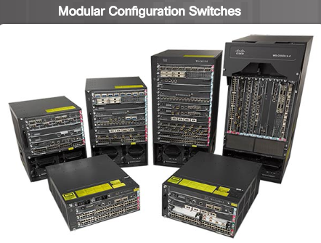
Switch Hardware Switch Platforms
Selecting the proper hardware to meet the current network requirements is critical when designing a network.
There are five categories of switches for enterprise networks:
Campus LAN switches
Cloud-managed switches
Data center switches
Service provider switches
Virtual networking
Various factors to consider when selecting switches include these:
Fixed vs. modular configuration
Stackable vs. nonstackable
Thickness of the switch (rack units)
Cost, port density, power, reliability
The chassis accepts line cards that contain the ports
Notes:
1.2 – Selecting Network Devices
1.2.1 – Switch Hardware
1.2.1.1 – Switch Platforms

Slide 24
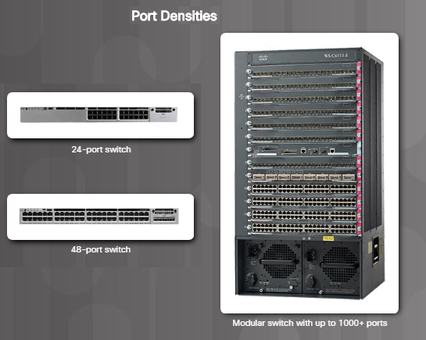
Switch Hardware Port Density
The port density of a switch refers to the number of ports on a single switch.
Fixed configuration switches support a variety of port density configurations:
Cisco Catalyst 3850 24 port and 48 port switches (see figure)
The 48 port switch has an option for four additional ports for pluggable SFP devices.
The modular Catalyst 6500 switch shown in the figure can support over 1,000 switch ports.
Modular switches are usually more appropriate in large networks in order to reduce space and power issues.
Notes:
1.2 – Selecting Network Devices
1.2.1 – Switch Hardware
1.2.1.2 – Port Density

Slide 25
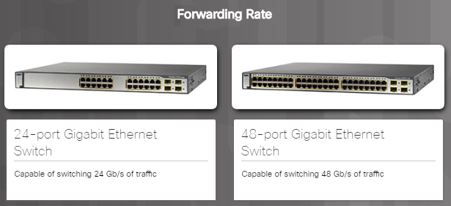
Switch Hardware Forwarding Rates
Entry-level switches have lower forwarding rates than enterprise-level switches.
Forwarding Rates are an important factor when selecting a switch because if the rate is too low, it will not be able to support full wire-speed communication across all of its switch ports.
Access layer switches typically do not need to operate at full wire speed because they are physically limited by their uplinks to the distribution layer.
Higher performing switches are needed at the distribution and core layers.
Switch product lines are classified by forwarding rates.
Forwarding rates define the processing capabilities of a switch by rating how much data the switch can process per second.
Notes:
1.2 – Selecting Network Devices
1.2.1 – Switch Hardware
1.2.1.3 – Forwarding Rates

Slide 26
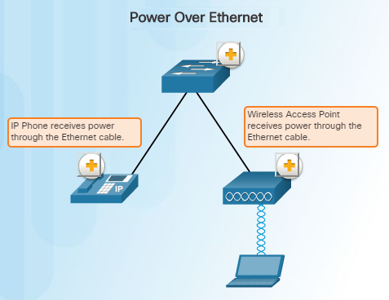
Switch Hardware Power over Ethernet
PoE allows the switch to deliver power to a device over the existing Ethernet cabling.
This eliminates the need for a power cable to the networked device such an IP phone or wireless access point.
PoE allows more flexibility when installing wireless access points and IP phones by allowing them to be installed anywhere that there is an Ethernet cable.
The Cisco Catalyst 2960-C and 3560-C Series compact switches support PoE pass-through.
PoE pass-through devices can power PoE devices as well as the switch itself by drawing power from certain upstream switches.
Notes:
1.2 – Selecting Network Devices
1.2.1 – Switch Hardware
1.2.1.4 – Power over Ethernet

Slide 27
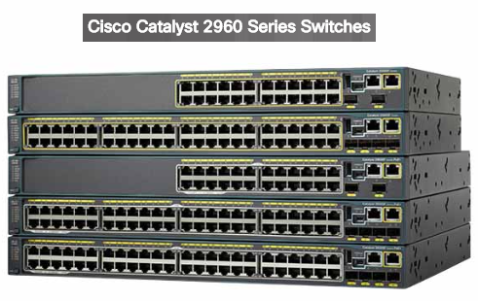
Switch Hardware Multilayer Switching
Multilayer switches are typically deployed in the core and distribution layer.
Multilayer switches can do the following:
Build a routing table and support routing protocols
Forward IP packets at a rate close to that of Layer 2 forwarding
Multilayer switches often support specialized hardware called application-specific integrated circuits (ASICs).
ASICs along with dedicated software can streamline the forwarding of IP packets independent of the CPU.
There is a trend in networking toward a pure Layer 3 switched environment.
Notes:
1.2 – Selecting Network Devices
1.2.1 – Switch Hardware
1.2.1.5 – Multilayer Switching

Slide 28
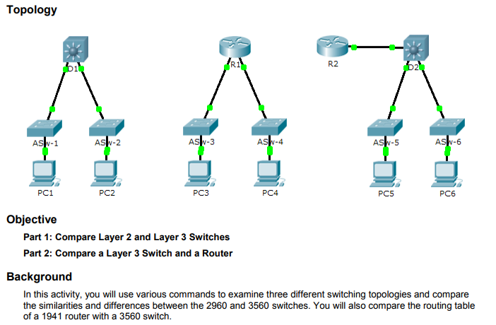
Switch Hardware Packet Tracer – Comparing 2960 and 3560 Switches
This Packet Tracer activity will allow you to use various commands to compare and examine three different switching topologies and compare the 2960 and 3560 switches.
You will also compare the routing table of a 1941 router and a 3560 switch.
Notes:
1.2 – Selecting Network Devices
1.2.1 – Switch Hardware
1.2.1.7 – Packet Tracer – Comparing 2960 and 3560 Switches

Slide 29
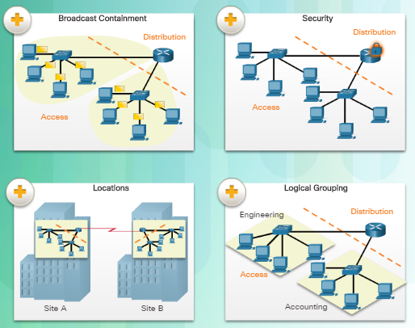
Router Hardware Router Requirements
Routing is required within the distribution layer of an enterprise network. Without routing, packets could not leave the local network.
Routers are critical networking devices because they are responsible for:
Connecting businesses and homes to the Internet
Interconnecting multiple sites within an enterprise network
Connecting ISPs on the Internet
Translating between different media types and protocols
Finding alternate paths if a link or path goes down
Notes:
1.2 – Selecting Network Devices
1.2.2 – Router Hardware
1.2.2.1 – Router Requirements

Slide 30
Router Hardware Router Requirements (Cont.)
Routers also serve other important functions:
Provide broadcast containment by limiting broadcasts to the local network
Group users logically by application or department
Provide enhanced security through the use of access control lists in order to filter unwanted traffic.
Interconnect geographically separated locations.
Notes:
1.2 – Selecting Network Devices
1.2.2 – Router Hardware
1.2.2.1 – Router Requirements

Slide 31
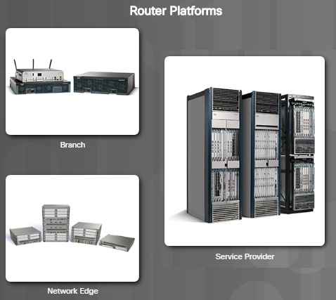
Router Hardware Cisco Routers
Selecting the proper router or routers is an important task for the network administrator in order to accommodate a growing network. There are three categories of routers:
Branch routers – Branch routers optimize branch services on a single platform while delivering an optimal application experience across branch and WAN infrastructures.
Network edge routers – Network edge routers enable the network edge to deliver high-performance, highly secure, and reliable services that unite campus, data center, and branch networks.
Service provider routers – Service provider routers differentiate the service portfolio and increase revenues by delivering end-to-end scalable solutions and subscriber-aware services.
Notes:
1.2 – Selecting Network Devices
1.2.2 – Router Hardware
1.2.2.2 – Cisco Routers

Slide 32
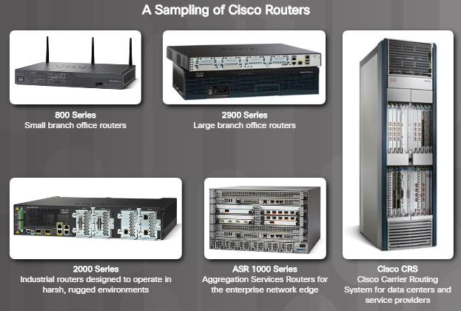
Router Hardware Router Hardware
Routers come in many forms:
They range in size from a small desktop router to a rack-mounted or blade model router.
They can be categorized as fixed configuration or modular.
They come with a variety of interfaces such as Fast Ethernet, Gigabit Ethernet, Serial, and fiber-optic.
As an example, the Cisco 1941 router comes with two Gigabit Ethernet RJ-45 interfaces built-in and two slots that can accommodate many different network interface modules.
Notes:
1.2 – Selecting Network Devices
1.2.2 – Router Hardware
1.2.2.3 – Router Hardware

Slide 33
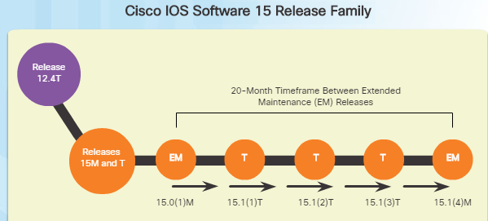
Managing Devices Managing IOS Files and Licensing
When selecting or upgrading a Cisco IOS device, it is important to choose the proper IOS image with the correct feature set and version.
IOS refers to the package of routing, switching, security, and other internetworking technologies integrated into a single multitasking operating system.
When a new device is shipped, it comes preinstalled with the software image and corresponding permanent licenses for the customer-specified packages and features.
For routers beginning with Cisco IOS Software release 15.0, Cisco modified the process to enable new technologies within the IOS feature sets.
Notes:
1.2 – Selecting Network Devices
1.2.3 – Managing Devices
1.2.3.1 – Managing IOS Files and Licensing

Slide 34
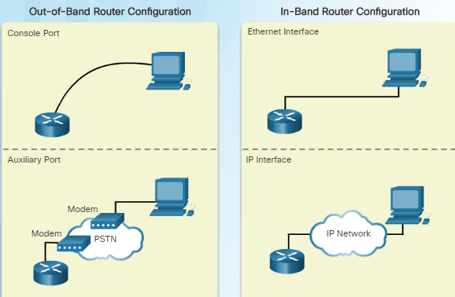
Managing Devices In-band versus Out-of-band Management
There are two methods for connecting a PC to a network device for configuration and monitoring tasks:
Out-of-band management through the use of the console or AUX port is used for the initial configuration or when a network connection is not available.
In-band management is used to configure or monitor the device remotely through a network connection using either SSH or HTTPs.
A reachable and operational network interface is required.
For security reasons, the use of Telnet and HTTP are not recommended.
Notes:
1.2 – Selecting Network Devices
1.2.3 – Managing Devices
1.2.3.2 – In-Band versus Out-of-Band Management

Slide 35
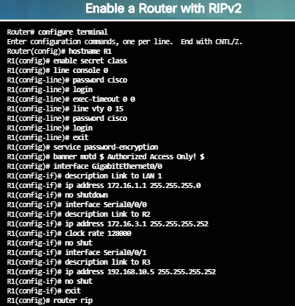
Managing Devices Basic Router CLI Commands
As shown in the figure to the left, a basic router configuration includes as follows:
Hostname for identification
Passwords for security
Assignment of IP addresses to interfaces for connectivity
Basic routing
Verify and save configuration changes with the copy running-config startup-config command
To clear the router configuration, use the erase startup-config and reload commands.
Notes:
1.2 – Selecting Network Devices
1.2.3 – Managing Devices
1.2.3.3 – Basic outer CLI Commands

Slide 36
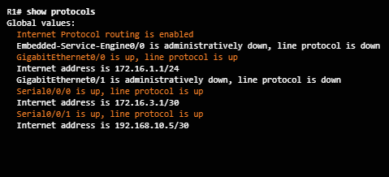
Managing Devices Basic Router Show Commands
The following are some of the most common show commands:
Routing Related:
show ip protocols –Displays information about the routing protocols configured
show ip route – Displays detailed routing table information including routing codes, known networks, administrative distance and metrics, how routes were learned, next hop, static routes, and default routes
Interface Related:
show interfaces – Displays interfaces with line status, bandwidth, delay, reliability, encapsulation, duplex, and I/O statistics
Notes:
1.2 – Selecting Network Devices
1.2.3 – Managing Devices
1.2.3.4 – Basic Router Show Commands

Slide 37
Managing Devices Basic Router Show Commands (Cont.)
show ip interfaces – Displays interface information including protocol status, IPv4 address, if a helper address is configured, and whether an ACL is enabled on the interface
show ip interface brief –Displays all interfaces with IPv4 addressing information and interface and line protocol status
show protocols – Displays information about the routed protocol that is enabled, and the protocol status of the interfaces
Other connectivity related commands include show cdp neighbors. This command displays information on directly connected Cisco devices including Device ID, the local interface the device is connected to, capability, the platform, and Port ID of the remote device. The details option provides the IP address.
Notes:
1.2 – Selecting Network Devices
1.2.3 – Managing Devices
1.2.3.4 – Basic Router Show Commands

Slide 38
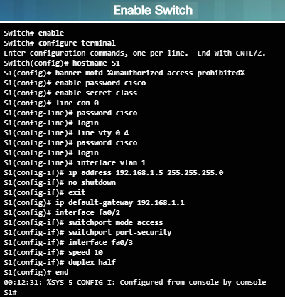
Managing Devices Basic Switch CLI Commands
Basic switch configuration includes these:
Hostname for identification
Passwords for security
Assignment of IP addresses for connectivity. In band-access requires the switch to have an IP address.
See the figure on the left for the commands used to enable and configure the switch.
Use the copy running-config startup-config command to verify and save the switch configuration.
Use the erase startup-config and reload commands to clear the switch configuration.
Notes:
1.2 – Selecting Network Devices
1.2.3 – Managing Devices
1.2.3.5 – Basic Switch CLI Commands

Slide 39
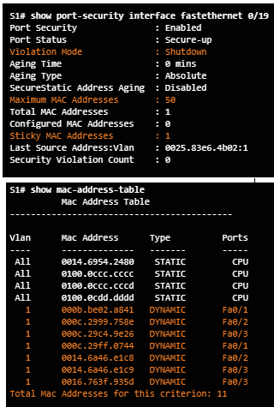
Managing Devices Basic Switch Show Commands
Switches make use of common IOS commands for configuration, to check for connectivity, and to display current switch status. Here are some very useful commands:
show port-security – Displays any ports with security activated. Include the interface ID to examine a specific interface.
show port-security address – Displays all secure MAC addresses configured on all switch interfaces.
show interfaces – Displays one or all interfaces with line protocol status, bandwidth, delay, reliability, encapsulation, duplex, and I/O statistics.
show mac-address-table – Displays all MAC addresses that the switch has learned, how they were learned, port number, and the VLAN assigned to the port.
Cisco switches also support the show cdp neighbors command.
Notes:
1.2 – Selecting Network Devices
1.2.3 – Managing Devices
1.2.3.6 – Basic Switch Show Commands

Slide 40
1.3 Summary
Notes:
1 – LAN Design
1.3 – Summary

Slide 41
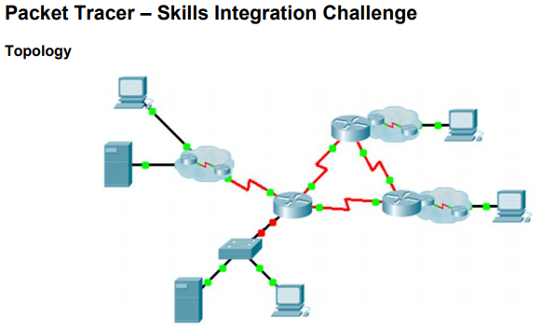
Summary Packet Tracer – Skills Integration Challenge
This Packet Tracer activity will require you to practice many of the skills that you have acquired so far during your CCNA studies.
You will first complete the documentation for the network before implementing various requirements.
Finally, you will be required to use your documentation to verify your implementation by testing end-to-end connectivity.
Notes:
1.3 – Summary
1.3.1 – Summary
1.3.1.3 – Packet Tracer – Skills Integration Challenge

Slide 42
Summary Chapter 1: LAN Design
Explain why it is important to design a scalable hierarchical network.
Select network devices based on feature compatibility and network requirements.
Notes:
1.3 – Summary
1.3.1 – Summary
1.3.1.4 – Chapter 1: LAN Design

Slide 43
Chapter 1 New Terms and Commands
Mission-critical services Enterprise network Mission-critical services Network operations center (NOC) Hierarchical design model Access layer Distribution layer Core layer Collapsed core design Multilayer switch Link aggregation Redundancy Spanning Tree Protocol (STP) | Failure domain Wireless access point (AP) Building switch block Departmental switch block EtherChannel Port channel interface Load balancing Open Shortest Path First (OSPF) Enhanced Interior Gateway Routing Protocol (EIGRP) Link-state routing protocol Single area OSPF Multiarea OSPF Distance vector routing protocol
Notes:
New Terms and Commands

Slide 44
Chapter 1 New Terms and Commands (Cont.)
Form factor Power Over Ethernet (PoE) Campus LAN switch Cloud-managed switch Data center switch Service provider switch Virtual networking switch Fixed configuration Modular configuration Stackable configuration Rack unit Supervisor engine Port density | Small form-factor pluggable (SFP) Forwarding rates Wire speed Application-specific integrated circuits (ASICs) Branch router Network edge router Service provider router Cisco Internetwork Operating System (IOS) IOS image Out-of-band management In-band management PuTTY TeraTerm
Notes:
New Terms and Commands

